Slide 1


Heart Rate Estimation using Remote Photoplethysmography
201030017_Bellam Keerthana
2010030095-Malayala.Nissie
2010030104-M.Sravani Chowdary
2010030485-P.Mounika Reddy
Guide
Dr.Arpita Gupta

Slide 2
Table Of Contents
Introduction
Problem statement
Motivation
Objective
Literature Survey
Dataset
Flow Diagram
Pre-Processing
Models
Conclusion
References

Slide 3
Introduction
Heart rate is a significant indicator of the functional and psycho-emotional status of humans. Remote photoplethysmography is useful in situations where conventional approaches to heart rate estimation like an electrocardiogram and photoplethysmography require physical contact with the subject is unfeasible. Acquiring the rPPG signal is useful for estimating physiological signals such as heart rate (HR) and heart rate variation (HRV), which are important parameters for remote healthcare. . With the development of the computer vision algorithm, remote heart rate measurement using remote photoplethysmography (rPPG) was proposed. Remote photoplethysmography (rPPG) monitors heart rate without physical contact, allowing for many applications. The deep learning rPPG has outperformed traditional approaches in a controlled context.

Slide 4
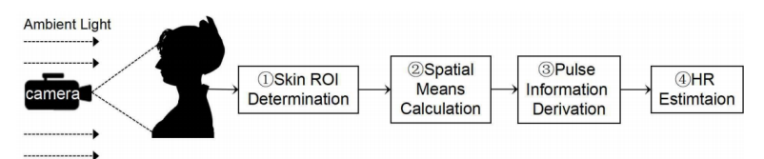
Problem Statement
For any emerging issues in a telehealth session, the patient's face is an essential source of wellness information as it is most visible to the health professional. The primary motto is to monitor the heart rhythm without the need for physical contact.

Slide 5
Motivation
With the COVID-19 era, everyone acknowledged the importance of Self-care. we believe it will be very useful to create an AI application that will help people know their heart rate by simply looking at their computer screen. This will also make it possible to diagnose their health virtually by a doctor.

Slide 6
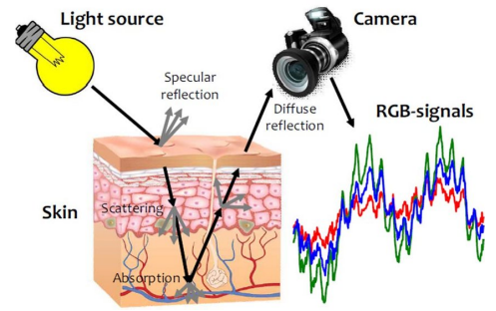
Objective
In this project, we attempt to measure heart rates in humans using camera-based remote photoplethysmography (RPPG) methods, named after traditional PPG. The fundamental idea is based on capturing minute changes in skin color during a cardiac cycle of the human body, involving the inﬂow and outﬂow of blood from the heart to other body parts. rPPG signals are usually collected using a video camera with a limitation of being sensitive to multiple contributing factors, such as different skin tones, lighting condition of environment and facial structure.

Slide 7
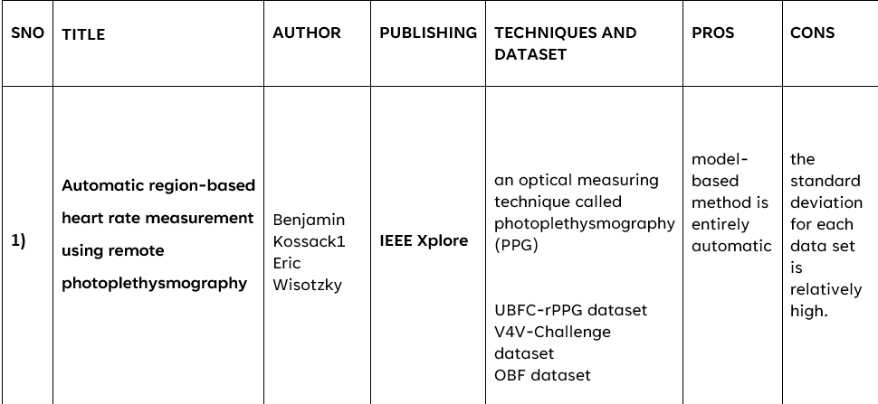
Literature Survey-01

Slide 8
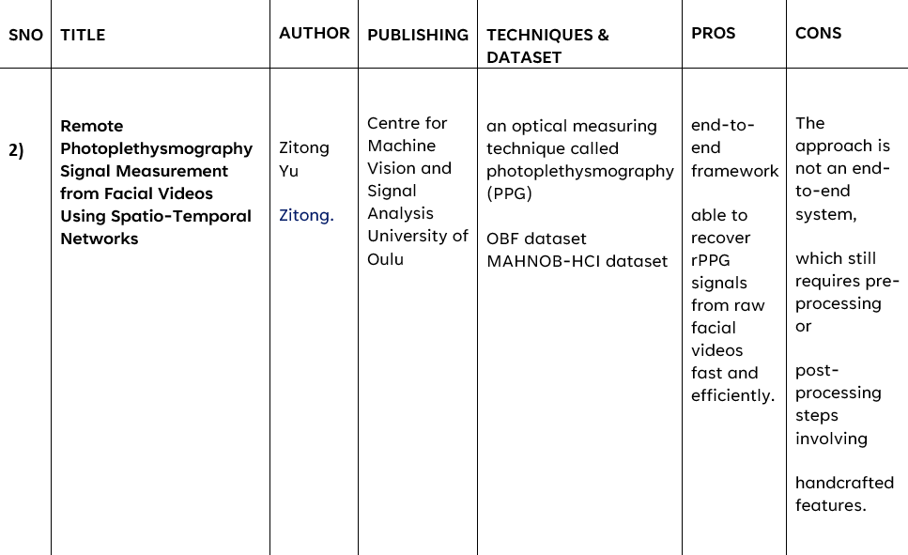
Literature Survey-02

Slide 9
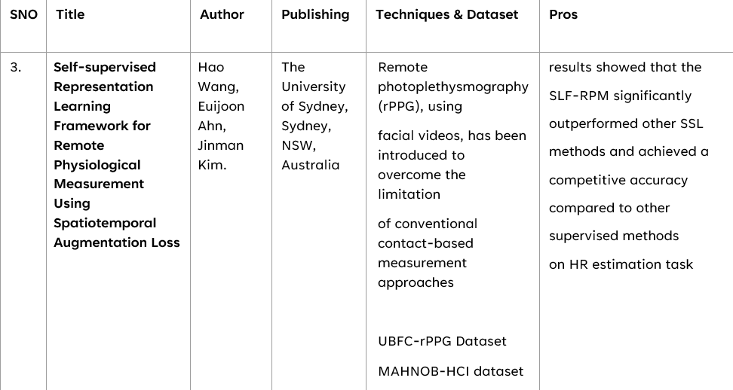
Literature Survey-03

Slide 10
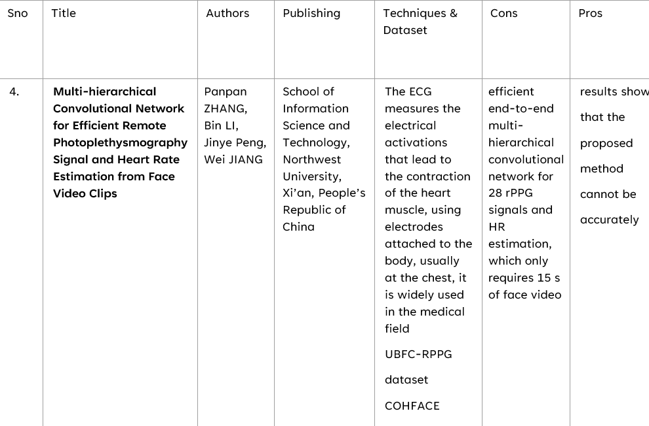
Literature Survey-04

Slide 11
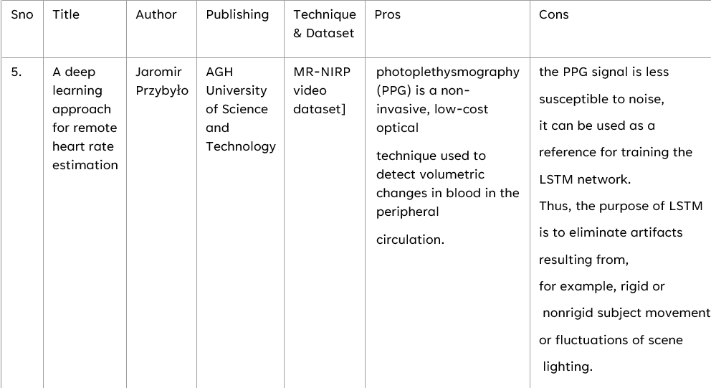
Literature Survey-05

Slide 12
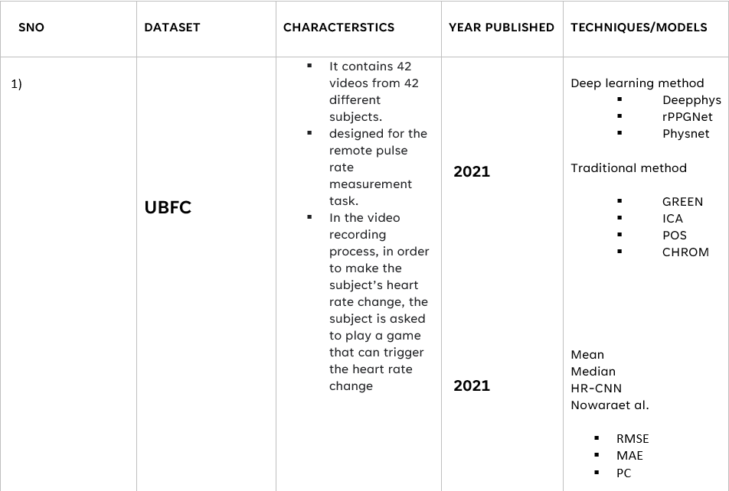
Dataset

Slide 13
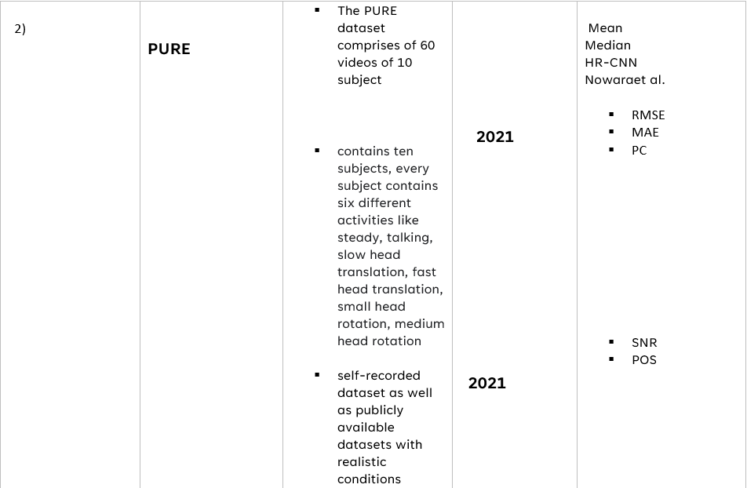
Dataset

Slide 14
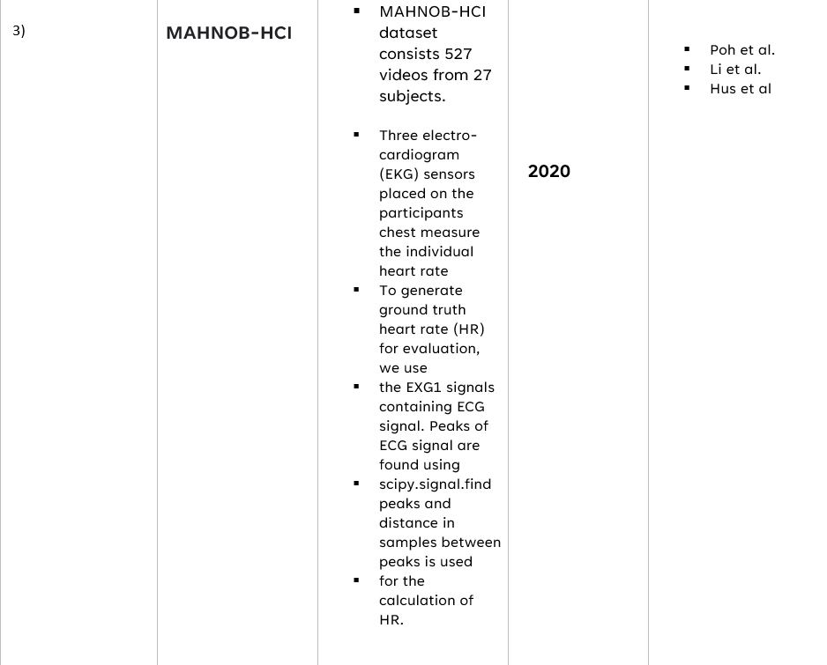
Dataset

Slide 15
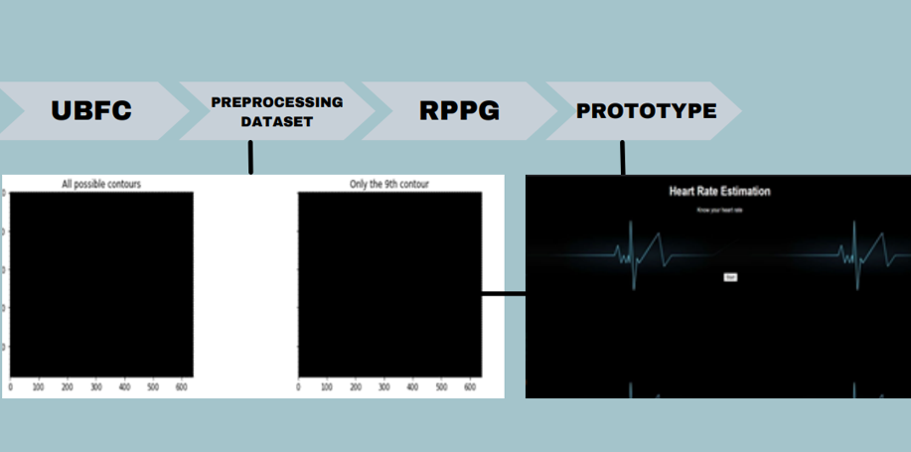
Flow Diagram

Slide 16
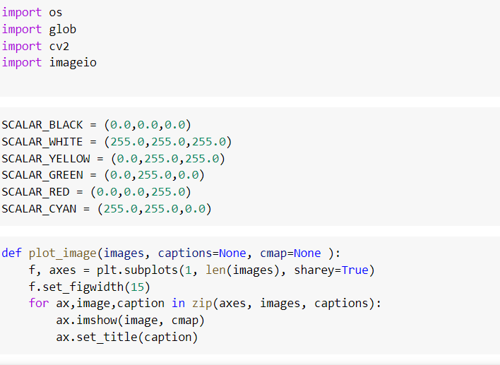
Preprocessing code

Slide 17
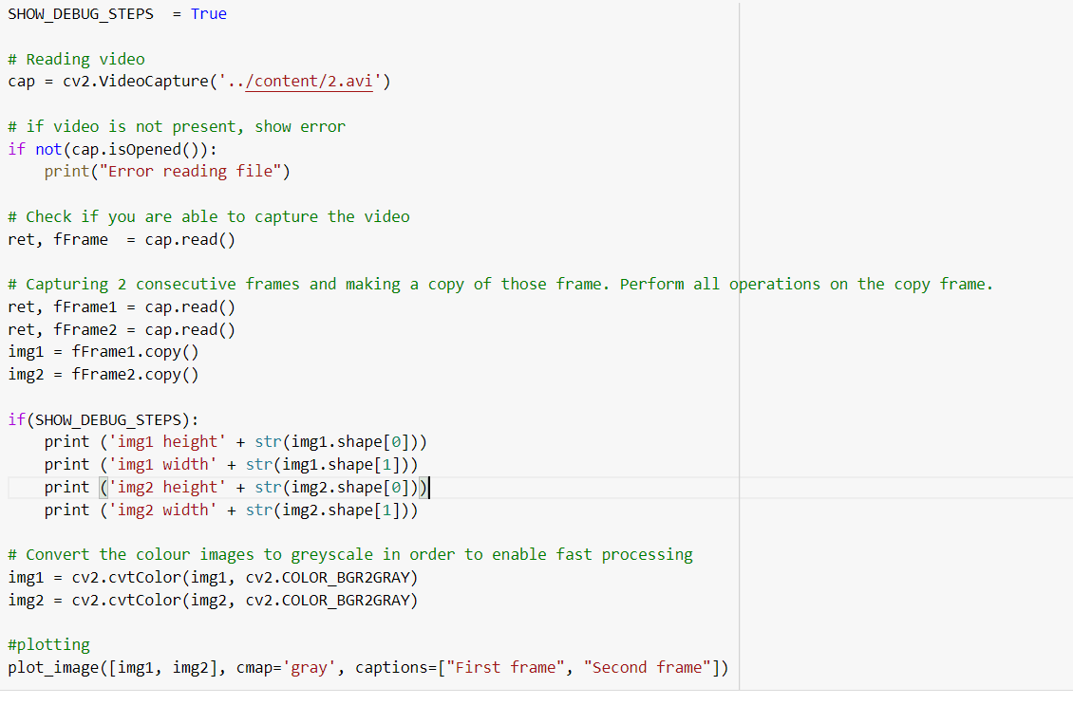

Slide 18
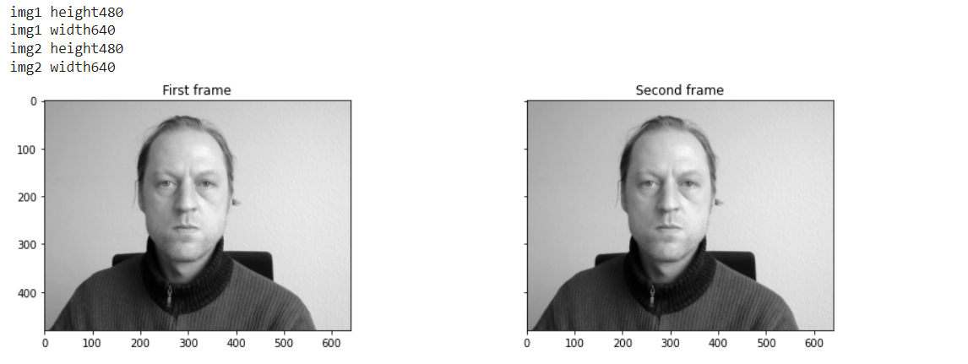

Slide 19
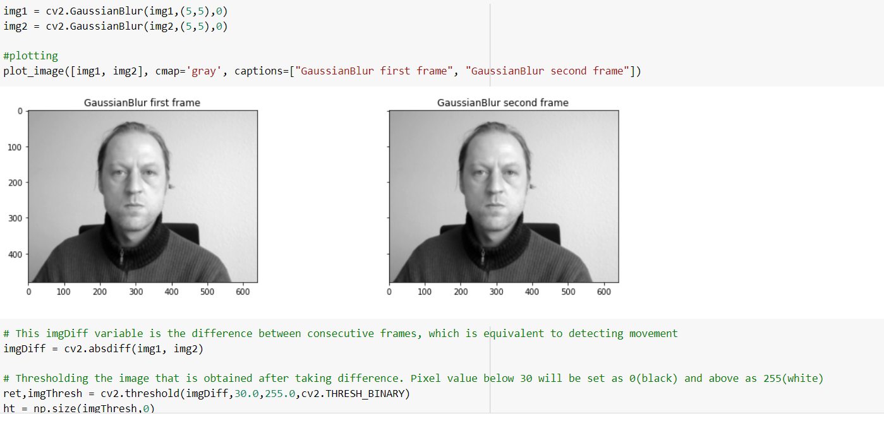

Slide 20
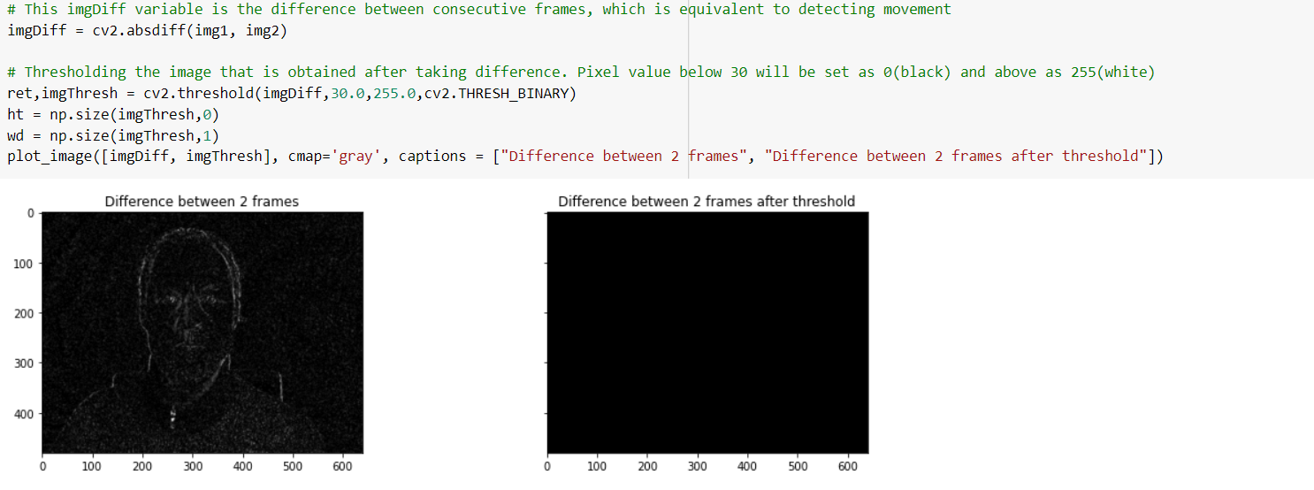

Slide 21
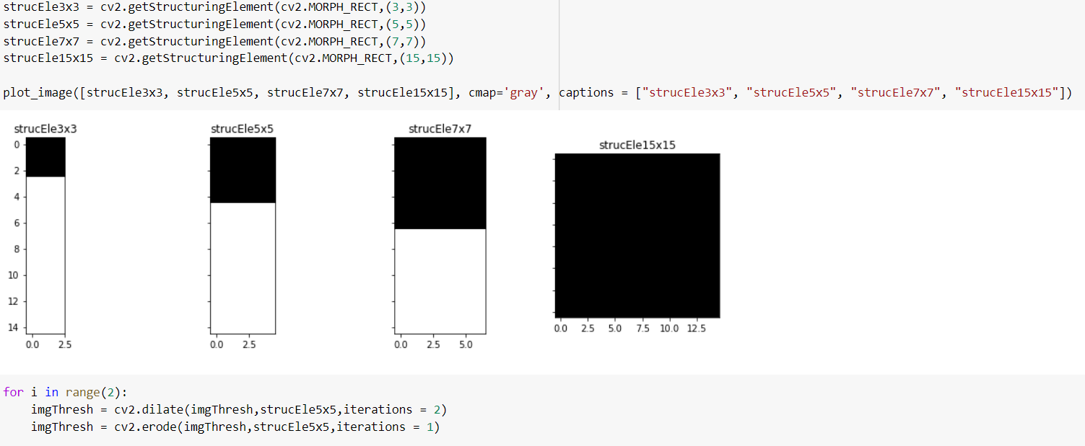

Slide 22
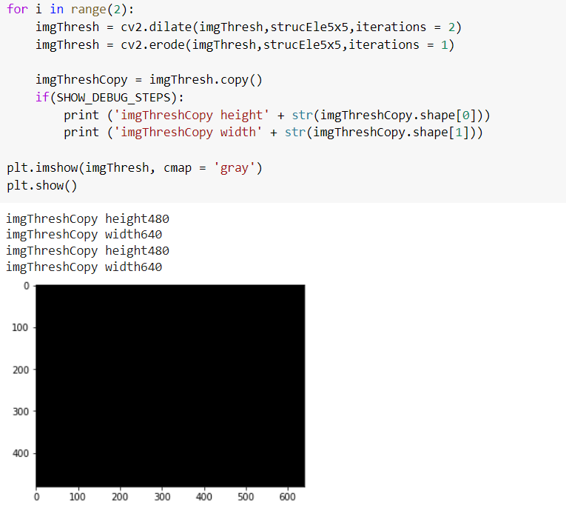

Slide 23
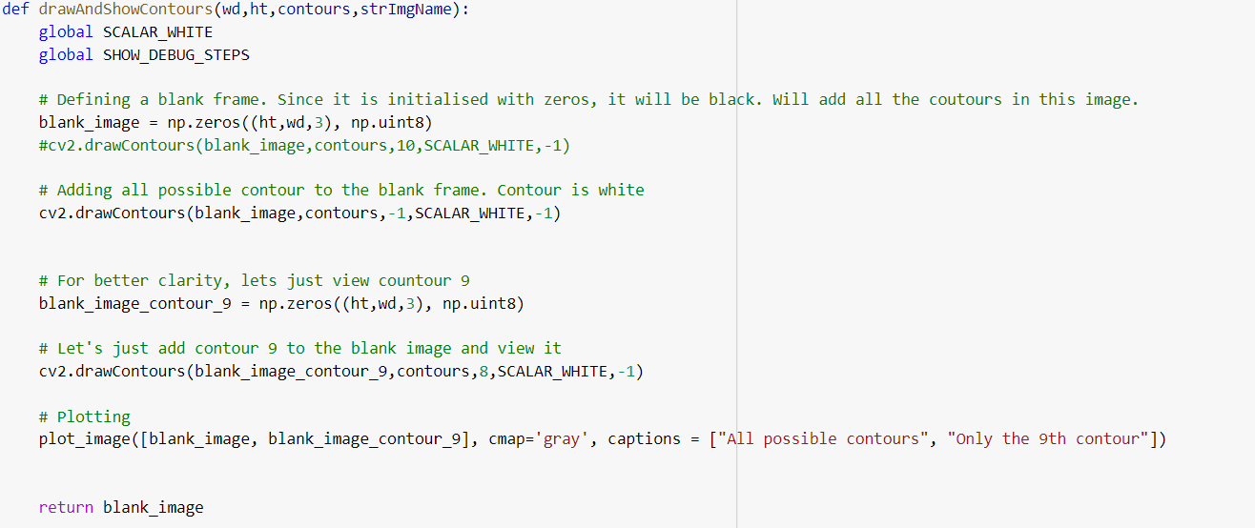

Slide 24
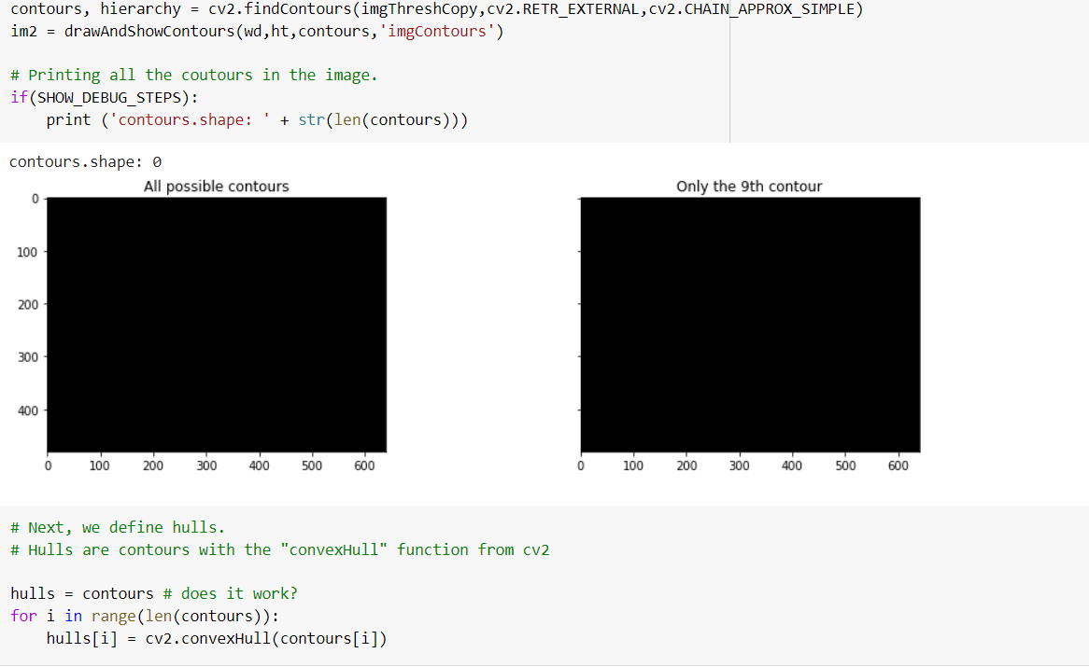

Slide 25
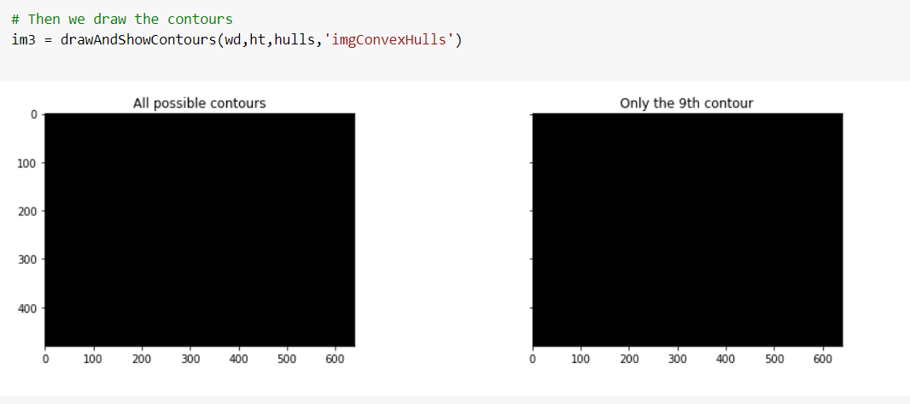

Slide 26
Selected Model
A two-stage end-to-end method, we will first introduce our video enhancement network STVEN. then introduce the rPPG signal recovery network rPPGNet
STVEN-rPPGNet
This deep learning-based method considers low-resolution input video clips to measure the heart rate. Its training occurs in two stages. The first stage involves a video enhancement network (called STVEN) whose output corresponds to spatially enhanced videos. The second stage involves a measurement network (called rPPGNet) whose output provides the heart rate. The measurement network rPPGNet is formed using a spatiotemporal convolutional network, a skin-based attention module, and a partition constraint module. The skin-based attention module selects skin regions. The partition constraint module enables an improved representation of the rPPG signal.

Slide 27
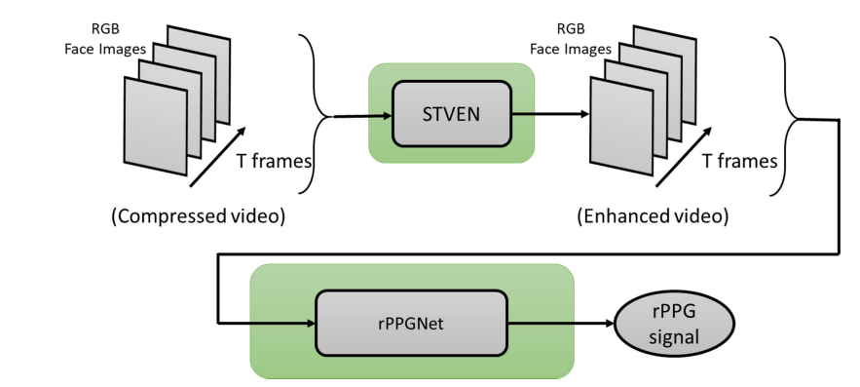
The STVEN, which is a video-to-video translation generator aided with fine-grained learning, is the first video compression enhancement network to boost rPPG measurement on highly compressed videos.
The rPPGNet, featured with a skin-based attention module and partition constraints, can measure accurately at both HR and HRV levels.
We want to conduct the cross-dataset test and show that the STVEN can generalize well to enhance unseen, highly compressed facial videos for robust rPPG measurement, which implies promising potential in real-world applications.

Slide 28
Conclusion
Remote heart rate estimation is the measurement of heart rate without any physical contact with the patients. In the pandemic period, telehealth and remote health monitoring have become increasingly important and people widely expect that this will have a permanent effect on healthcare systems.
According to the information from literature studies we can say that deep learning-based methods generally give more correct and faster results than traditional methods.

Slide 29
References
1) Yang, Ze, Haofei Wang, and Feng Lu. "Assessment of Deep Learning-based Heart Rate Estimation using Remote Photoplethysmography under Different Illuminations." arXiv preprint arXiv:2107.13193 (2021)
2) Gideon, John, and Simon Stent. "The way to my heart is through contrastive learning: Remote photoplethysmography from unlabelled video." In Proceedings of the IEEE/CVF International Conference on Computer Vision, pp. 3995-4004. 2021.
3) Ryu, JongSong, SunChol Hong, Shili Liang, SinIl Pak, Qingyue Chen, and Shifeng Yan. "Research on the combination of color channels in heart rate measurement based on photoplethysmography imaging." Journal of Biomedical Optics 26, no. 2 (2021): 025003.

Slide 30
SUGGESTIONS

Slide 31
THANK YOU..!

